Slide 1
The Office of Manufacturing and Energy Supply Chains
US DRIVE Overview
October 21, 2024
Stephanie Jennings
Supply Chain Deployment Manager
Notes:
Add verbal introduction

Slide 2
Securing the foundation of America's Energy Future
Keeping the lights on today. Training the workforce for tomorrow.
Analysis
MESC Conducts Cutting-Edge Economic and Technical Analyses to Identify the Gaps and Growth Opportunities Across the Nation's Energy Supply Chains.
Manufacturing
Making the U.S. Energy System More Secure
14 Manufacturing Facilities Built or Retrofitted,
with 16 More Facilities in the Project Pipeline
8,495 Permanent and Construction Jobs Created
$127M Total Direct Investments in Clean Energy Workforce to Date
Workforce

Slide 3
MESC is all about de-risking energy supply chains
      MESC’s Core Functions
      MESC’s Vision
Manufacturing Investing
Strengthening and securing the
energy supply chains America needs for a secure, clean and
equitable energy system
Workforce
Investing
Supporting workforce skills development by directly funding
cutting-edge energy manufacturing training programs
To eliminate vulnerabilities in US clean energy supply chains, while driving unparalleled social, economic, and environmental impact through our
Programs & awards
Manufacturing Analytics Backbone
Robust modeling to guide and support DOE strategy and investments, private sector collaborative investments, and federal policy recommendations

Slide 4
MESC operates in late-stage technology development, driving large-scale deployment of new technologies
The Office of Manufacturing and Energy Supply Chains is working alongside private capital to be a force multiplier to secure American supply chains domestically.
All DOE and MESC investments follow a data-driven approach, building on modeling, mapping, and analysis foundational from MESC experts.
MESC is supporting workforce through direct funding of cutting-edge energy manufacturing programs at universities, community college, and trade-schools to provide entry-level and mid-career support.
Technology maturity and example DOE offices
Research and Development
LPO
i.e., debt financing
Demonstration
Deployment
MESC
i.e., growth equity
Adoption
Technology Readiness Level (TRL)
FECM
i.E critical material demo
EERE
i.e., seed capital
OCED
i.e., early stage equity
ARPA-E
i.e., angel investors
  Commercialization

Slide 5




2024 MESC Goals
Strengthen U.S Manufacturing Capacity and Workforce
30,528
TOTAL JOBS CREATED
$20B
MADE AVAILABLE
PERMANENT JOBS
CONSTRUCTION JOBS
21,243
Achieved to date
  Create average of 150+ jobs per project
20,000
Enabled
15,000
Enabled
  Invest $1B in GREEN INDUSTRIAL FACILITIES
9,285
Achieved to date
$600M
$1B
To date, we have invested $600 million across the 40209 Advanced Manufacturing in Energy Communities program and through 48C tax credit allocations to go towards new-build green industrial product facilities.

Slide 6
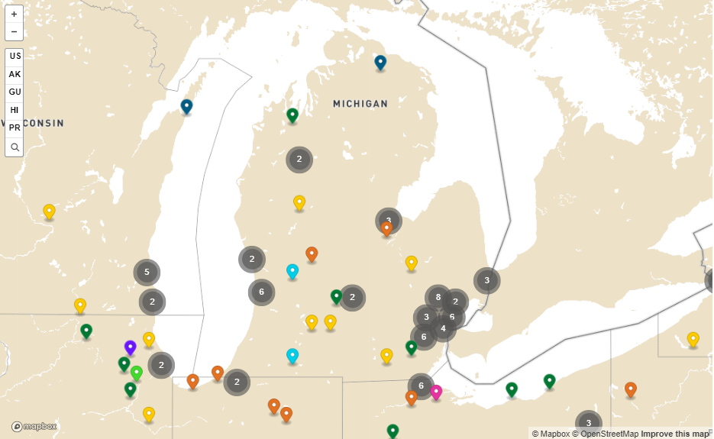
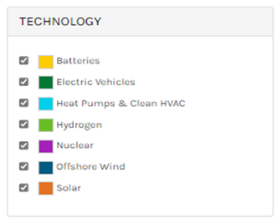
Manufacturing is accelerating across clean energy technologies
US MANUFACTURING
INVESTMENT ANNOUNCEMENTS
$120 billion+ Batteries
$35 billion+ EVs & EV Chargers
$16 billion+ Solar
$3.5 billion+ Offshore Wind
$2 billion+ Electrolyzers & Fuel Cells
Notes:
Our topline finding—based on DOE and EPA analyses just released in December—show that the Inflation Reduction Act and Bipartisan Infrastructure Law can help drive down U.S. net greenhouse gas emissions by as much as 41% below 2005 levels by 2030. - Voluntary Supplement to the U.S. Fifth Biennial Report 2023 | UNFCCC https://unfccc.int/documents/635393
This represents a near doubling in emissions reductions compared to what was expected before IRA and BIL.
This legislation puts the U.S. in a strong position to achieve our climate goals through additional action, including private sector investment catalyzed by IRA and BIL.
These bills represent a historic investment in energy and climate action through a combination of tax credits, direct federal spending, competitive grants, and loan programs,
And are projected to rapidly spur clean energy and transportation deployment, increase energy efficiency, deploy enabling infrastructure, innovate across sectors, expand and secure supply chains, and ensure that benefits are equitable.

Slide 7
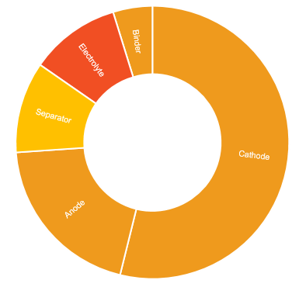
U.S. battery supply chain readiness scored as “moderate” as domestic production ramps up
Supply Chain Readiness Example: NMC-Gr, 2024: MODERATE
Trading partner relationships add stability, with mature supplier inputs, end customers, and markets
US production faces cost competitiveness challenges against global price benchmarks (~20% price delta) across upstream materials and manufacturing
Overall readiness
Electrolyte: low readiness on supplier maturity and cost competitiveness
Low
High
Cathode: limited due to sourcing risk management reliance on PRC for processing of lithium, nickel, and cobalt.
Separators: moderate, due to available supply from trading partners
NMC-Gr battery
Anode: limited, due to sourcing risk management and cost competitiveness related to PRC production capacity
Upstream Materials
Limited due to nascent processing and refining capacity for battery-grade metals and materials
Manufacturing
Moderate due to available supply and customers in domestic and trading partner markets
Workforce
Low due to labor supply and demand gap and hiring difficulty compared to other manufacturing sectors

Slide 8
MESC Programs
Current MESC Programming
OPEN FOR APPLICATIONS |  | UNDER REVIEW |  | SELECTED FOR NEGOTIATION
 | Industrial Assessment Centers Implementation Grants ($400 million) |  | Advanced Manufacturing and Recycling Grants R2 ($425 million)* |  | Advanced Manufacturing and Recycling Grants R1 ($275 million)
 | Extended Product System Rebates ($10 million) |  | Smart Manufacturing & Recycling Tactics for States (SMART) Grant Program ($63 million) |  | Consumer Electronics Battery Recycling, Reprocessing, and Battery Collection for States & Local Government ($7.2 million) & Retailers ($15 million)
 |  |  | Domestic Manufacturing Conversion Grants Program State Set Aside ($50 million) |  | Defense Production Act – Heat Pumps Manufacturing R1 ($169 million) & R2 ($63 million)*
 |  |  |  |  | Domestic Manufacturing Conversion Grants Program ($2 billion)*
 |  |  | 48C Tax Credits R2 ($6 billion)*
 |  |  |  |  | IAC Clean Energy Manufacturing Workforce Training and Technical Assistance Awards R1($32 million) & R2 ($24 million)
* prior submission of a concept paper required for to submit a full application |  |  |  |  | IAC Clean Energy Manufacturing Workforce Training and Technical Assistance Awards R1($32 million) & R2 ($24 million)
 |  |  |  |  | State Manufacturing Leadership Program ($22 million)
 |  |  |  |  | Battery Material Processing and Battery Manufacturing Grants ($3.5 billion)

Slide 9
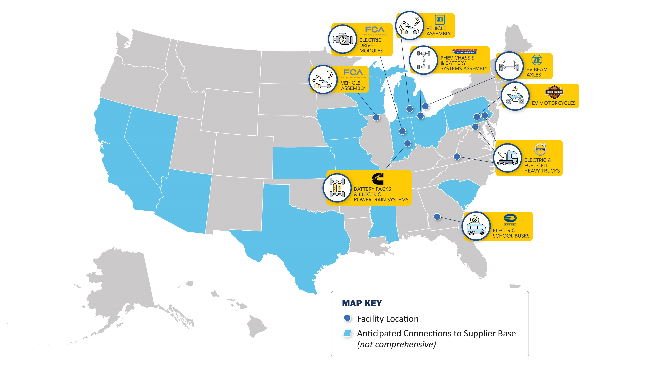
IRA 50143: Domestic Conversion Grants Program – Direct Investments
$1.7 billion in grant funding to convert 11 at-risk or shuttered ICE facilities to EV production
50% cost share with grantees
$4.9 billion in total economic value
Over 3,700 jobs created
15,000 jobs retained
Production anticipated to start Q2 2026 with full conversions by Q4 2028

Slide 10
IRA 50143: Domestic Conversion Grants Program – State Partnerships
Program Overview
Formula grant funding from MESC to six states with significant automotive manufacturing workforces: Michigan, Ohio, Indiana, Tennessee, Kentucky, and Illinois
Program Requirements
Projects must convert an existing facility from ICE to EV supply chain
50% cost share minimum – state to determine source of matching funds
State to define eligible small and medium manufacturers
Funds to cover capital or operating expenditures
$50 million set-aside from $2 billion in IRA 50143 funding to target manufacturers lower in the automotive supply chain
State determines the entity that will manage the program and grants
Currently reviewing applications for award in late 2024/early 2025

Slide 11




BIL 40521: Industrial Training and Assessment Centers – Small Supplier EV Transition Playbook
MESC and Argonne National Laboratory developed a small supplier EV transition playbook. The playbook covers several topics:
Which internal combustion vehicle products face greater tailwinds and headwinds in the clean energy transition
Possible EV/clean energy market opportunities, and how to identify others
Approaches to prioritizing and pursuing new market opportunities
Operational considerations, including financing, workforce, new certifications/standards requirements, etc.
Expected public release: Late 2024 / early 2025
EV/Clean energy conversion and diversification
$1.5 million in funding awarded to interdisciplinary ITAC teams to deploy and refine playbook:
 | Purdue University Manufacturing Extension Partnership + Conexus Indiana
 | University of Michigan and Michigan State ITAC
 | UI-Chicago ITAC, Argonne National Lab, Illinois Manufacturers Association, Midwest Energy Efficiency Alliance

Slide 12
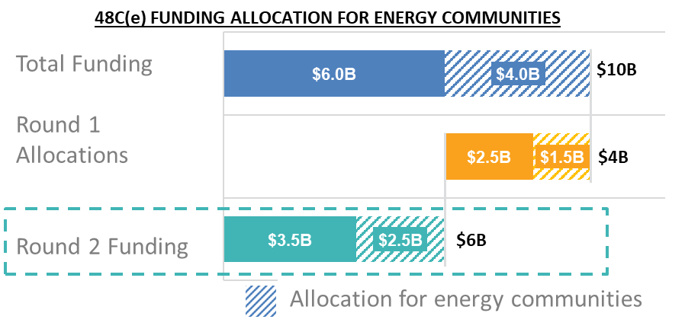
Qualifying Advanced Energy Credit (48C) Overview
48C(e) Expanded with $10B in Funding
Key Considerations for Round 2
Competitively-awarded Investment Tax Credit (ITC) first established by the 2009 Recovery Act
Expanded by IRA in 2022 with $10B for
  Clean Energy Manufacturing/Recycling
  Critical Materials
  Industrial Decarbonization Projects
DOE accepted a first round of applications in 2023, and IRS allocated $4 billion of the program’s $10B total​
Round 2 Announced in April 2024 for up to $6 billion​
Selected projects receive up to a 30% ITC (6% if apprenticeship and prevailing wage requirements are not met)
In certain circumstances, applicable entities can elect for direct pay in lieu of a tax credit
At least 40% of all credits will be allocated to projects in 48C(e) energy communities
Open to all project sizes
DOE will not predetermine funding allocated to each category
Applicants who did not receive an allocation in Round 1 are eligible to apply in Round 2

Slide 13
BIL 40207: Consumer Electronics Battery Recycling, Reprocessing, and Battery Collection for State and Local Governments and Retailers
Appropriations of $65 million to assist States and units of local government, and retailers with battery collection and recycling
Grants to establish or enhance battery collection, recycling, and reprocessing programs.
Up to $10M per grant, proposal must include a 50% cost share.
Programs can focus on any or all recycling steps such as collecting, handling, sorting, storing, and transporting spent and discarded batteries and electronics containing batteries up to the physical recycling process.

Slide 14
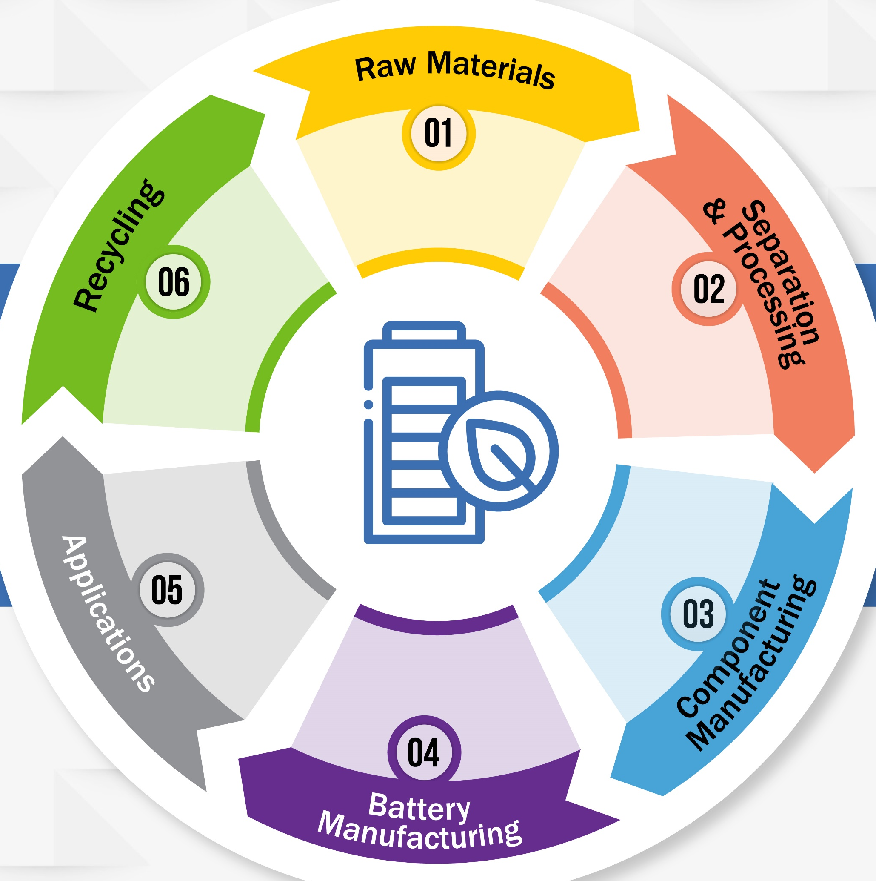
BIL 40207: Battery Material Processing and Manufacturing Grants – Round 1

Slide 15
BIL 40207: Battery Material Processing and Manufacturing Grants – Round 2

Slide 16
MESC is working to deploy an additional $20B+ across workforce, batteries, and ESIB initiatives
  MESC INVESTMENTS ($B)
  25
$20B+
Amount outstanding to be invested
  1.5
  0.25
  20
  20
  2.0
  0.6
  6.2
  2.2
  15
  0.6
  0.4
  2.2
  7.8
$2.8B
  3.0
Invested in batteries and critical minerals, to-date
  10
  10.0
  4.0
  5
  9.5
  6.0
  0
~15%
  Tax Credits / Rebates
  Batteries / Critical Minerals
  EV Mfg Conversion
  Workforce
  DPA Heat Pumps
  Total
Funding awarded or with investment underway
  Awarded
  Investment underway
  Solicited
  To be invested

Slide 17
MESC’s
Impacts
To-Date
$3.9B+ private sector investment catalyzed
9,205 construction and permanent jobs created
38% of investments in energy communities or J40 communities
1000+ students trained annually
1.3M+ EVs enabled annually
$54.5M+ in benefits flowing to communities through Community Benefits Plans

Slide 18
Connect
With MESC

