Slide 1
Building a Future Where Everyone Can Ride and Drive Electric
Rachael Nealer, PhD
US DRIVE and 21st Century Truck All Technical Team Meeting
October 21, 2024

Slide 2
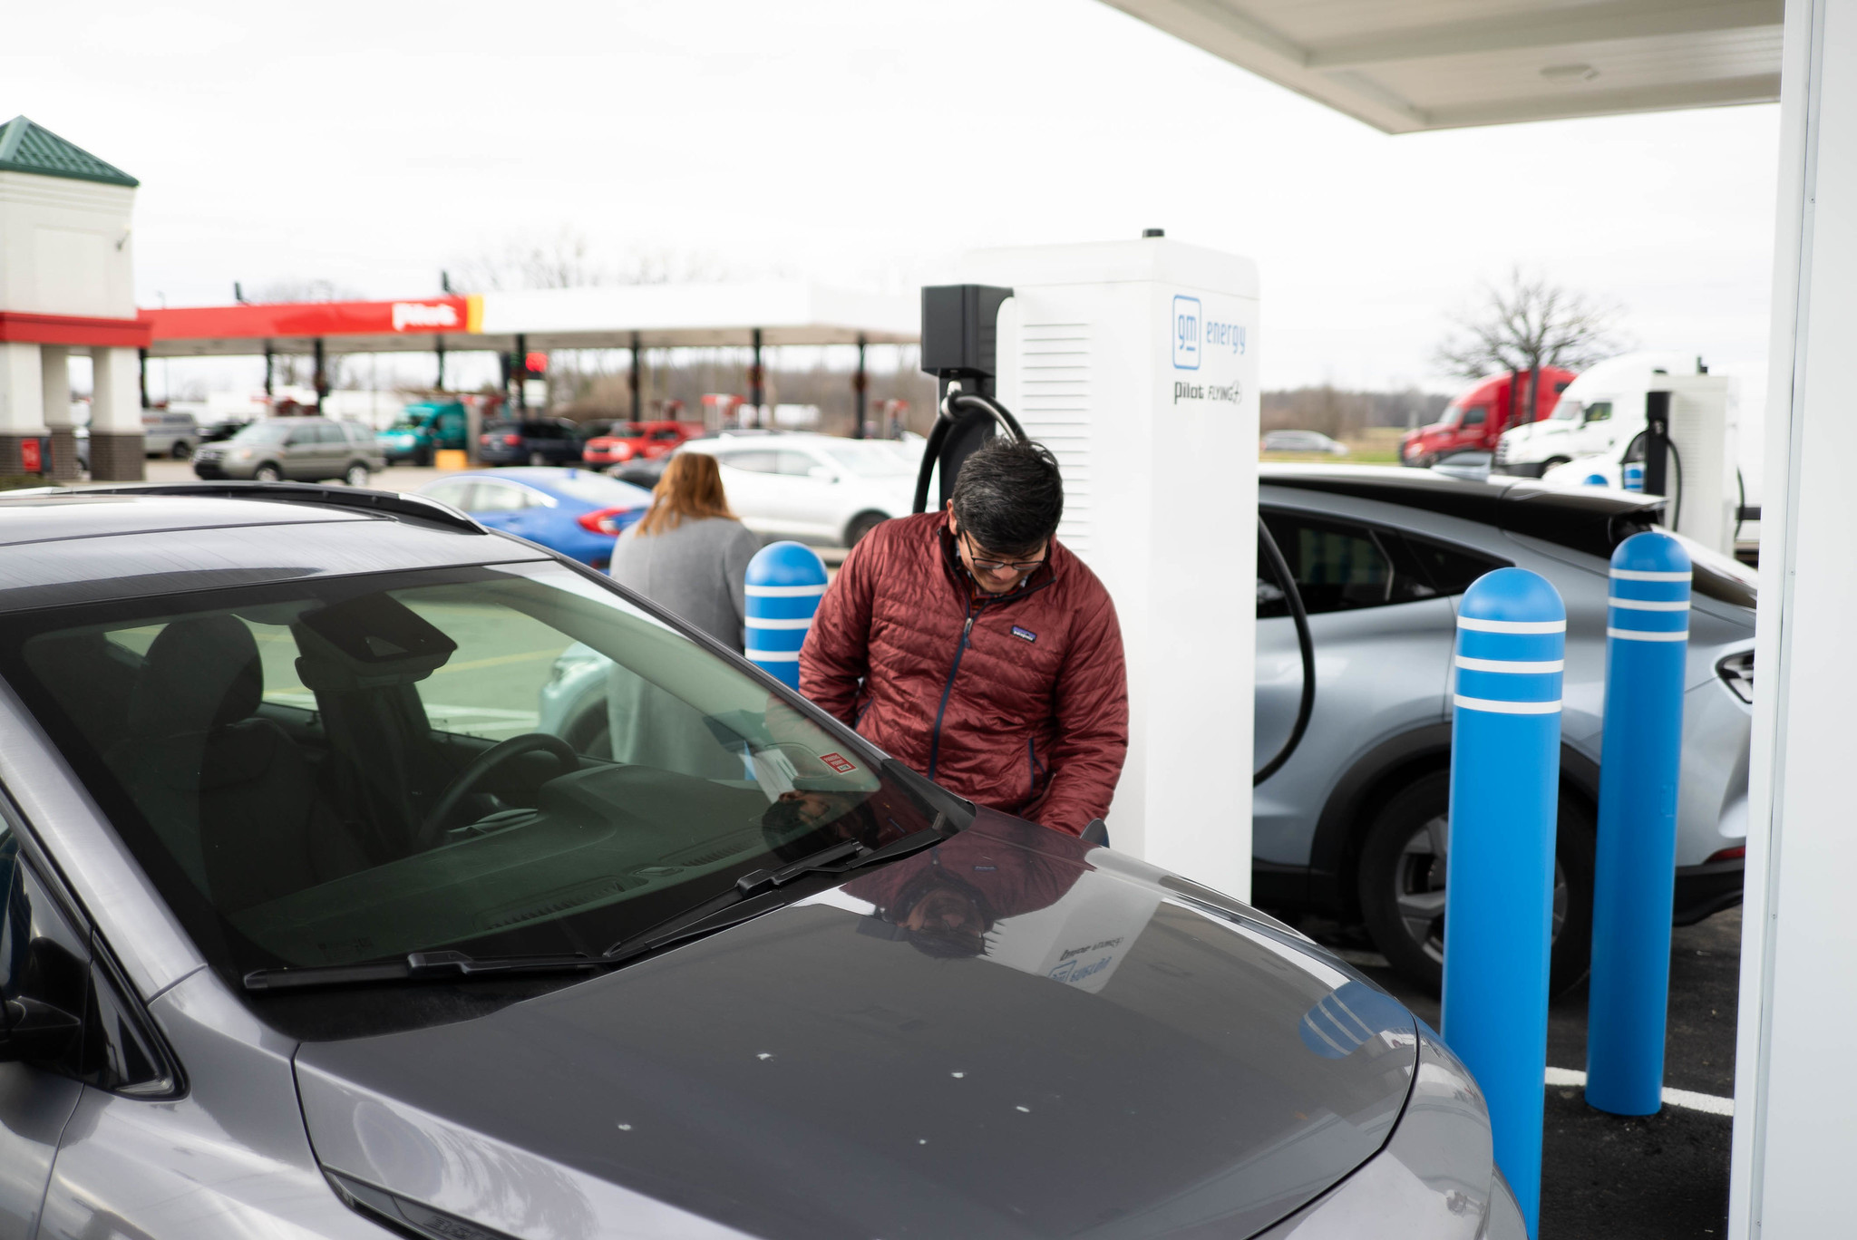
The Biden-Harris Administration is prioritizing building a network of 500,000 public chargers by 2030
Since President Biden took office, the number of publicly available charging ports has doubled
Currently the US has more than 200,000 public charging ports
40% of the way to the Biden Administration goal
1 in every 10 vehicles sold is an EV
First NEVI station charging session in London, Ohio
Source: Ohio DOT
Notes:
Last updated 10/15/24

Slide 3
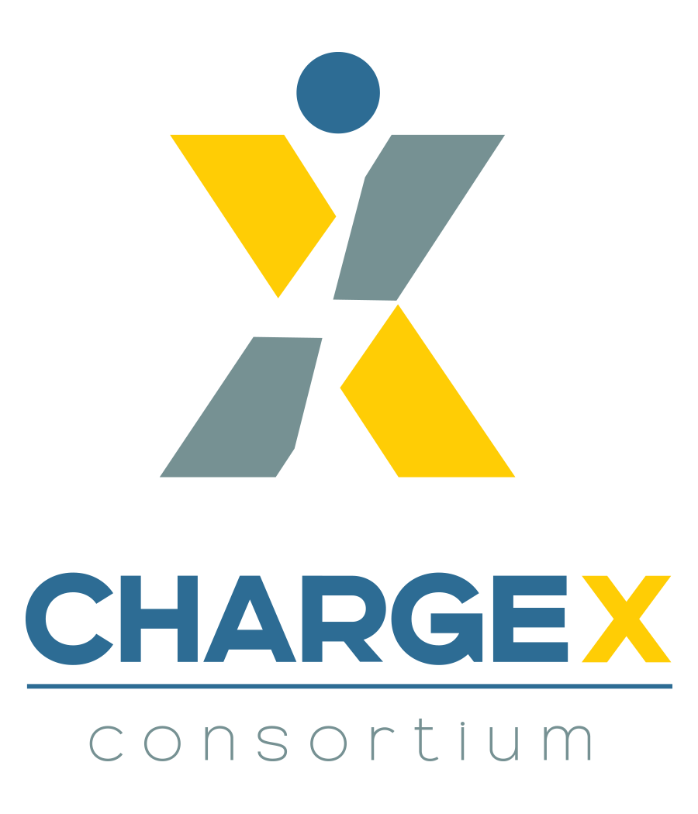
To support charging reliability, the Joint Office has funded the ChargeX Consortium
Lead by
Notes:
the national laboratories will closely collaborate with more than 70 organizations representing a cross-section of the EV industry to address three problematic areas:
Payment processing and user interface
Vehicle-charger communication
Diagnostic data sharing.
Will measure and significantly improve public charging reliability and usability in North America within 24 months
The ChargeX Consortium builds on the foundation for charging reliability established by the minimum standards for Federal Highway Administration Title 23 funded EV charging infrastructure projects. It also complements two other Joint Office-supported efforts:
The Joint Office Ride and Drive Electric Funding Opportunity Announcement that intends to improve EV charging performance and reliability by, in part, increasing commercial capacity for testing and certification of high-power EV chargers and validating high-power EV charger real-world performance and reliability.
The creation of a centralized data platform for EV charger data reporting that will facilitate and maximize access to data and insights that could inform future charging reliability analysis.

Slide 4
Electric Vehicle Working Group
Initial subcommittees focus on these areas
Crosscutting Topics
Charging Network
Equity
Ensure an electrified transportation future that benefits all Americans
Understand need and plan to spur adoption
Workforce
Develop the workforce needed to support all aspects of the electric vehicle industry
Medium/Heavy Duty
Grid Integration
Supply Chain
Build a resilient supply chain that delivers the goods needed to support the electric vehicle industry
Use the float button to change the basic setting of circular chart.
Ensure the sustainable integration of EVs into the electric grid
Address the unique needs of the MD/HD industry
Add short description here. Add short description here.
driveelectric.gov | 4

Slide 5
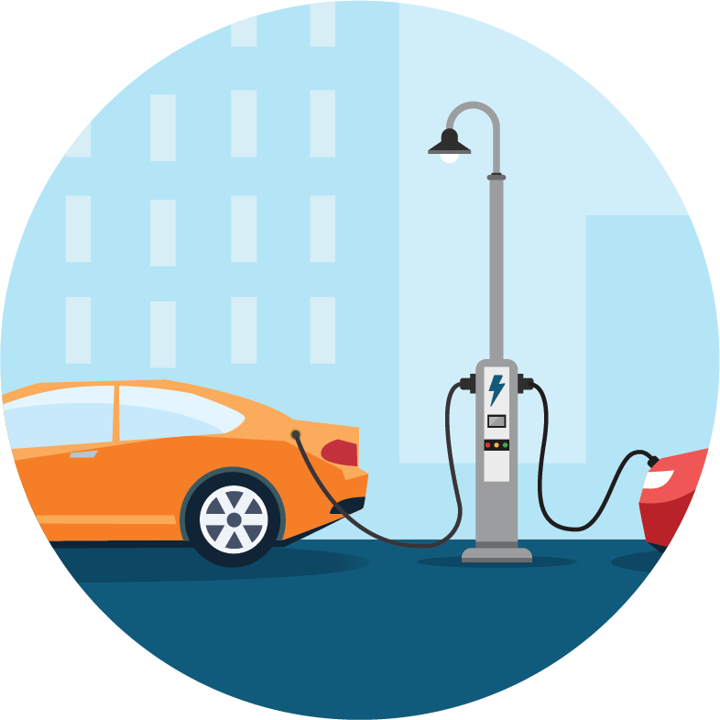
ORIGINS AND TARGETS OF MALICIOUS ACTIVITY SURROUNDING EV CHARGING INFRASTRUCTURE
Communications Infrastructure & Mobile Applications
Payment & Financial Services
Personally Identifiable Information
Electricity Generation and Transmission
Transportation Services
Electric Vehicle
Charging Infrastructure
Information Technology

Slide 6
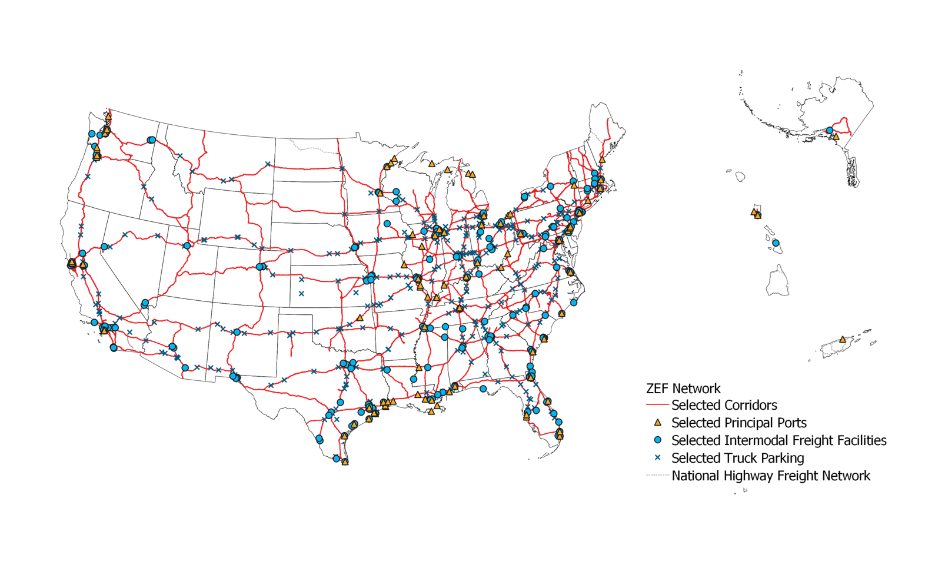
Goal
The National Zero-Emission Freight Corridor Strategy seeks to align and accelerate cross-sector investments in zero-emission medium- and heavy-duty vehicle (ZE-MHDV) infrastructure and clearly signal the need to bolster electric grid and hydrogen planning to achieve a zero-emission freight network by 2040.

Slide 7
Joint Office is supporting over $19 billion in BIL funding for clean transportation
National Electric Vehicle Infrastructure (NEVI) Formula Program (U.S. DOT)
$5 billion for states to build a national EV charging network along corridors, including $148 million awarded to repair and replace non-operational chargers.
Charging & Fueling Infrastructure Discretionary Grant Program (U.S. DOT)
$2.5 billion for communities to build EV charging, as well as hydrogen, natural gas, and propane fueling infrastructure
Low-No Emissions Grants Program for Transit (U.S. DOT)
$5.6 billion for transit agencies to deploy low- and no-emission transit buses
Clean School Bus Program (U.S. EPA)
$5 billion in support of electric school bus deployments
Clean Heavy Duty Vehicles Program (U.S. EPA)
$1 billion to replace existing Class 6 and Class 7 non-zero-emission heavy-duty vehicles
Ride & Drive Funding Opportunity (Joint Office)
$46.5 million to enhance charging resiliency and performance and enhance equitable access
Communities Taking Charge Funding Opportunity (Joint Office)
$54 million to expand community e-mobility access
Notes:
The Joint Office provides unifying guidance, technical assistance, and analysis to support the following programs:
The Joint Office supports several programs that were established in the Bipartisan Infrastructure Law including:
The National Electric Vehicle Infrastructure, also known as “NEVI,” Formula Program. This program provides $5 billion in funding to states to strategically deploy EV charging infrastructure and establish an interconnected network to facilitate data collection, access, and reliability. This is designed to inspire confidence of EV drivers in a national charging network that will allow anyone to ride or drive electric. On September 27, 2022 the Joint Office announced that the Biden-Harris administration has approved Electric Vehicle Infrastructure Deployment Plans for all 50 states, Washington, D.C., and Puerto Rico ahead of schedule under the NEVI Formula Program.
There is also the NEVI Discretionary Program which provides $2.5 billion in community grants for EV charging, as well as hydrogen, natural gas, and propane fueling infrastructure.
The Low-No Emissions Grants Program for Transit provides $5.6 billion in support of low- and no-emission transit bus deployments.
the Clean School Bus Program distributes $5 billion in support of electric school bus deployments.
Ride and Drive
Communities Taking Charge

Slide 8
We’re in the middle, and the future is electric!
197K total publicly available charging ports
24.5K federally-funded publicly available charging ports underway
86 federally-funded publicly available ports operational in 10 states
Electric Vehicle Charging Infrastructure Growth · Joint Office of Energy and Transportation (driveelectric.gov)
Notes:
Last updated 10/15/24

Slide 9
Thank You
October 21, 2024
Notes:
Thank you.

